Slide 1
Project Proposal Presentation
ME 691: XVII SciML for Thermo-fluids
Name: Aditya Prasad (Fourth year ME undergrad)
Roll No. : 22110018
Notes:
Hii everyone. My name is Aditya Prasad. I am a fourth year ME undergraduate student

Slide 2
Contents
1.
Problem Statement
2.
Governing Equations
3.
Dataset
4.
SciML techniques
5.
NODE: In-depth
6.
References

Slide 3
Time Integration of 0D Chemical Kinetics simulations using Neural ODEs
Some Context to the Project title:
A 0D system models a perfectly mixed environment, focusing solely on how chemical concentrations change over time, completely ignoring any spatial variations.
A Neural ODE's job isn't to predict the next state, but to learn the system's differential function (dS/dt); this learned function is then handed to a classic numerical solver which integrates it to find the next state. In short, the neural network learns the physics, and the solver does the math.
Notes:
This is project title: Time Integration of 0D chemical kinetics simulations using NODE ML framework
For those who dont know:
By 0D chemical kinetics im referring to 0D chemical reactor systems. We consider there 0D systems to be fully homogeneous(physically and chemically). We focus solely on the chemical kinetics and ignore all spatial variations.
Goal: i am trying to successively predict the chemical state of the system using the previous states.
I’ll explain the Neural ODEs part later. Firstly i’ll explain the System im are trying to model.

Slide 4

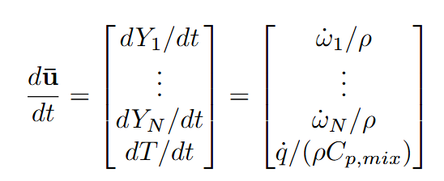
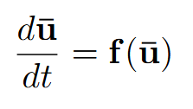
The change in this state vector over time is governed by the conservation equations for species and energy.
or
Here, the rate of heat release (q) is a linear combination of all the reaction rates (w_{i}’s), which in turn are a highly non-linear function of the species mass fractions (Y_{i}’s).
Governing Equations:
The chemical state of the system is completely defined by a single vector, u.
In the H2/Air 0D simulations we have 11 variables (10 Y_{k}’s and T).
System
State:
Notes:
State of a 0D chemical system: is composed of all the species mass fractions and the system temperature.
Governing equations:
The first N rows correspond to the conservation of mass for all the N species. Here w_doti is the species reaction rate. Mathematically, wdot_i is a non-linear combination of the elements The rate of change for each variable is interdependent.
The last row is the conservation of energy equation which drives the change in temperature of the 0D system.
In turn, the heat release (q) from these reactions is what drives the change in temperature.
In addition to it, we also have the ideal gas equation but takes no part in the time integration mechanism. We use the ideal gas equation only to update the system density after the calculation of all the other system variables.
The Neural ODE Framework (du/dt = f(u)):
This system perfectly fits the general form of an ODE which is needed for Neural ODE ML frameworks
Goal:
Our goal is to create a neural network that learns to approximate this complex and computationally expensive function f. By replacing the traditional calculation of f with a trained neural network, we can accelerate the entire simulation.

Slide 5
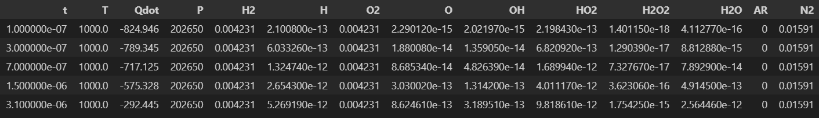
Dataset
H2/Air constant pressure 0D combustion dataset with irregular time step sizes.
ChemFoam solver in OpenFoam was used to generate this dataset.
Notes:
Now i will explain the dataset.
As you can see here, since i am trying to model the H2/Air 0D combustion we have 10 species mass fractions and Temperature for every chemical state calculated at different time stamps.
Other than t, Qdot(is just a linear combination of wi’s which in turn a nonlinear function of the species mass fractions), and P(is a constant value) all the other variables are our 11 state variables.
Btw this dataset was generated when i was working on a project course wherein i was working with OpenFoam.

Slide 6
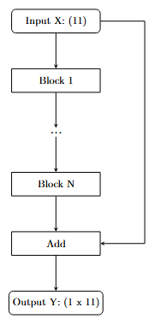


SciML Techniques
We can use many SciML techniques that can be used to create fast surrogate models for the stiff chemical kinetics. We can use MLP(with ‘physics’ loss term) or Recurrent Neural nets or ..
Residual Neural Nets
Neural ODE Framework
A ResNet acts like a sequence of discrete steps, where each layer adds a learned "residual" F(u) to its input.
Resnet Update Rule:
Euler Explicit Update Rule:
A Neural ODE learns the continuous dynamics of the system by modeling the differential function f(u, t) with a neural network.
This learned function f is then handed to a sophisticated external ODE solver (e.g., Runge-Kutta), which integrates the state forward in time with high accuracy.
Key Advantage: This decouples the physics model from the numerical solver. It avoids the fixed truncation error of ResNets by leveraging powerful, adaptive solvers, leading to more accurate and stable predictions.
Key Limitation: This structure is locked into a simple, fixed-step integration scheme. This introduces a first-order truncation error at every layer, fundamentally limiting the model's accuracy, regardless of how well it learns the function F.
Notes:
Q. Can we use MLP Neural Nets
We can input a chemical state and pass it through the network to get the next chemical state as the output. We can include a physics loss term to ensure that out model can satisfy the underlying physics.
But even after that, MLPs tend to have the error accumulation problem as we recursively predict the states after the another.
Hence MLPs are ruled out
Q. can we use RNNs
I know RNNs predict the state based on the memory its previous states. But this property has no use in our system.
Plus along with MLPs, RNNs also have a error accumulation problem.
Alongwith, it cannot be used on dynamically changing time steps.
Hence RNNs are ruled out.
In this slide i compare the two approaches: ResNets vs Neural ODE Frameworks
Handling of Time Steps: A Key Advantage
Works with Irregular Data: A major advantage of the NODE framework is its ability to handle data with irregular or adaptive time steps.
Learns Continuous Dynamics: Because the model learns the underlying continuous dynamics (du/dt) rather than a discrete-step function, it's completely independent of how the data was sampled over time.
Breaks a Key Limitation: This overcomes a major limitation of previous SciML techniques (like RNNs or ResNets), which require training data to be at uniform, regular time intervals (Δt). This gives us far more flexibility in the datasets we can use.

Slide 7
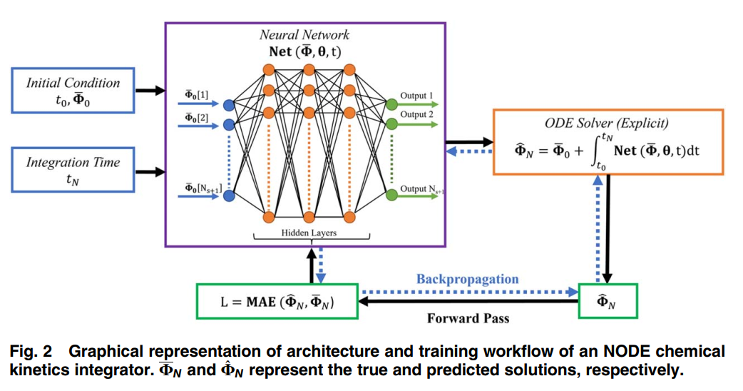
Neural ODE(NODE)
Neural ODE models the instantaneous rate of change (the derivative dΦ/dt) of a system's state.
The network (Net(Φ,θ,t)) learns the function f in dΦ/dt = f(Φ, t, θ), where Φ is the state (species mass fractions, temperature), t is time, and θ are the network's parameters.
Once trained, this learned f is the passed on to a numerical solver that integrates f over a given time interval (t_0 to t_N) to predict the system's future state.
Architecture Training: Instead of using the standard backpropagation, we use the Adjoint Sensitivity method to optimise our network parameters θ.
Instead of storing the entire computation graph (which would consume immense memory for long integrations), this method solves an auxiliary "adjoint" ODE backward in time.
Source: Bansude et al. (2022)
Notes:
As i had explained earlier, in NODE frameworks we predict the instantaneous rate of change of the system’s state.
As you can see in this schematic, we input the state at ti time and we predict the rate of change of all these individual variables. Since we know the previous state, and we have the predicted rates of change of state, we can plug-in the predicted differential function values to an external ODE numerical integrator like RK3, RK4, etc.
We can choose any integration time of our choice, we just need to make sure that the numerical integrator is sufficiently accurate enough.
Explain Overall training loop: Then mention about the Adjoint sensitivity method and tell that we have the governing equation loss included in its derivation.

Slide 8
References
Neural ODE Frameworks
Chen, R. T. Q., Rubanova, Y., Bettencourt, J., & Duvenaud, D. (2018). Neural Ordinary Differential Equations. Advances in Neural Information Processing Systems, 31.
Pal, P., Bhattacharya, S., & Sun, W. (2022). ChemNODE: A latent chemistry framework for efficient chemical kinetic solver. Combustion and Flame, 240, 112020.
Bansude, S., Pal, P., & Bhattacharya, S. (2022). A data-driven framework for integration of chemical kinetics using neural ordinary differential equations. Combustion and Flame, 239, 111956.
Integration of Chemical Kinetics with ResNets
Nikitin, V. F., Zuev, B. K., & Kashtanov, V. S. (1998). Combustion chemistry prediction using neural networks for multi-species reaction systems. Mendeleev Communications, 8(1), 35-36.
Helpful YouTube Videos
Brunton, S. (2021, October 29). Neural ODEs (NODEs) [Physics Informed Machine Learning]. YouTube. https://www.youtube.com/watch?v=nJphsM4obOk
Computational Sciences. (2021, March 11). Adjoint State Method for an ODE | Adjoint Sensitivity Analysis. YouTube. https://www.youtube.com/watch?v=k6s2G5MZv-I
Notes:
These are the references. If you have any questions, feel free to ask.
Thank you.

Slide 9
Thank you

